Slide 1


Intro to
Programming
With python
classes:
part 1I
Friday, May 2 2025 TOH210
Notes:
Layout objects pulled from: https://slidesgo.com/
All icons are from: https://thenounproject.com/

Slide 2
classes 1I
Workbook
click for access
found on Moodle under this week

Slide 3

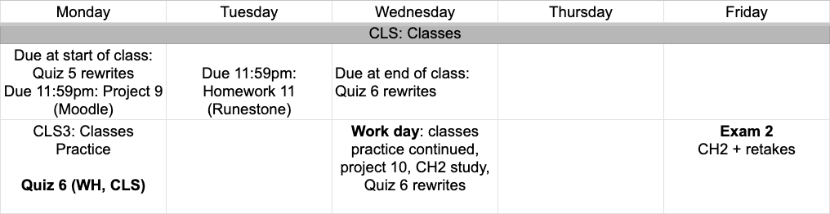
next week
google sheet link
Notes:
https://docs.google.com/forms/d/e/1FAIpQLSe3OloPAJSid4n6cyU_4qXpRWU7FOSmP7IVdRS_vh9cvYd9zQ/viewform?usp=sharing

Slide 4
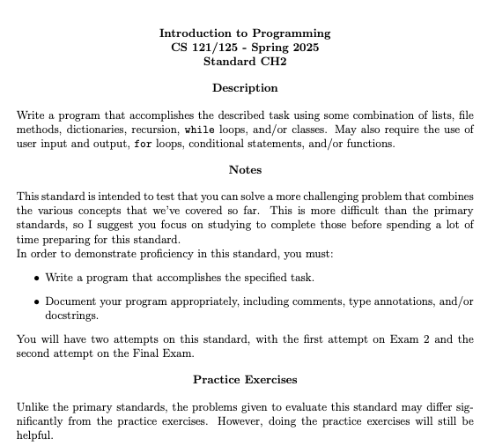

Slide 5
Takeaways from last time
defining classes
member variables/attributes
member functions/methods
accessor
mutator
constructor
class vs instance of a class

Slide 6
class Dog:
def __init__(self, n, a, b):
self.name = n
self.age = a
self.breed = b
Recap: let’s fill in these methods together
constructor
accessor
def get_name(self):
def birthday(self):
mutator
def get_age(self):
accessor

Slide 7

Warmup
student class
Define a class called Student, with the following:
member variables
last_name: a string given as an argument to the constructor
first_name:a string given as an argument to the constructor
dorm: a string given as an argument to the constructor
member functions
get_name: returns the full name of the student: “<first_name> <last_name>”
move: take the name of a dorm as an argument, changes the student's dorm to that one.

Slide 8
Example
pizza class
Define a class called Pizza, with the following:
member functions
add_topping: takes a string (new topping), and adds it to the list of toppings
get_price: computes and returns the cost of the pizza
small:$9 medium: $11 large: $14
each topping: $2
member variables
size: a string given as an argument to the constructor(small, medium, or large)
toppings:a list of toppings, initialized as an empty list

Slide 9
class Pizza:
member variables
size: a string given as an argument to the constructor (small, medium, or large)
toppings:a list of toppings, initialized as an empty list
def __init__(self, s):
self.size = s
self.toppings = []
member function
add_topping: takes a string (new topping), and adds it to the list of toppings
def add_toppings(self, item:str):
self.toppings.append(item)

Slide 10
class Pizza:
member function
get_price: computes and returns the cost of the pizza
small:$9
medium: $11
large: $14
each topping: $2
def get_price(self):
total_price = 0
return total_price
if self.size == "small":
total_price += 9
elif self.size == "medium":
total_price += 11
else:
total_price += 14
total_price += len(self.toppings) * 2

Slide 11
You may have noticed that if you print out your instance you get something like:
<__main__.Pizza object at 0x789181a0e020>
We can define the string representation of a class by defining a special method _ _str_ _
This changes what happens when you print an instance
of the class
class Pizza:
#str method
def __str__(self):
return self.size
+" pizza with "
+ (" & ").join(self.toppings)
prizza = Pizza("large")
prizza.add_topping("red onion")
prizza.add_topping("pineapple")
print(prizza)
large pizza with red onion & pineapple

Slide 12
exercise
bank account
Define a class called BankAccount, with the following:
member variables
account_number: an int given as an argument to the constructor
balance:a float, initialized to 0.00
member functions
deposit: takes a float, and adds it to the balance
__str__: returns string representation of “Account <account_number> has $ <balance>”

Slide 13

before next time
Finish workbook
Finish Project 9
Quiz 5 rewrites due on Monday

Slide 14
class Student:
#constructor
def __init__(self, last:str, first:str, d:str):
self.last_name = last
self.first_name = first
self.dorm = d
#methods
def get_name(self):
return self.first_name + " " + self.last_name
def move(self, d:str):
self.dorm = d

Slide 15
class BankAccount:
def __init__(self, num:int):
self.account_number = num
self.balance = 0.00
def deposit(self, money:float):
self.balance += money
def __str__(self):
return f"Account {self.account_number} has ${self.balance}"

